Slide 1
Chapter 26 - Java Object-Based Programming
Outline
26.1 Introduction
26.2 Implementing a Time Abstract Data Type with a Class
26.3 Class Scope
26.4 Creating Packages
26.5 Initializing Class Objects: Constructors
26.6 Using Set and Get Methods
26.7 Using the this Reference
26.8 Finalizers
26.9 Static Class Members

Slide 2
Objectives
In this chapter, you will learn:
  To understand encapsulation and data hiding.
  To understand the notions of data abstraction and abstract data types (ADTs).
  To create Java ADTs, namely classes.
  To be able to create, use and destroy objects.
  To be able to control access to object instance variables and methods.
  To appreciate the value of object orientation.
  To understand the use of the this reference.
  To understand class variables and class methods.

Slide 3
26.1 Introduction
Object-oriented programming (OOP)
  Encapsulates data (attributes) and functions (behavior) into packages called classes
  Data and functions closely related
Information hiding
  Implementation details are hidden within the classes themselves
Unit of Java programming: the class
  A class is like a blueprint – reusable
  Objects are instantiated (created) from the class
  For example, a house is an instance of a “blueprint class”
  C programmers concentrate on functions

Slide 4
26.2 Implementing a Time Abstract Data Type with a Class
In our example
  Define two classes, Time1 and TimeTest in separate files
    Only one public class per file
Class definitions
  Never really create definition from scratch
    Use extends to inherit data and methods from base class
    Derived class: class that inherits
  Every class in Java subclass of Object
    Gets useful methods, discussed later
  Class body
    Delineated by braces { }
    Define instance variables and methods

Slide 5
26.2 Implementing a Time Abstract Data Type with a Class (II)
Member-access modifiers
  public: accessible whenever program has a reference to an object of the class
  private: accessible only to member methods of that class
  Member variables are usually private
Methods
  Access methods: public methods that read/display data
    public interface
    Clients use references to interact with objects
  Utility methods: private methods that support access methods

Slide 6
26.2 Implementing a Time Abstract Data Type with a Class (II)
Constructor
  Special member function
    Same name as the class
  Initializes data members of a class object
  Constructors cannot return values
Definitions
  Once class defined, can be used as a data type
  Define objects of the class
  Time1 myTimeObject = new myTimeObject;
    Defines object, initializes with constructor

Slide 7
26.2 Implementing a Time Abstract Data Type with a Class (III)
import
  If no package specified for class, class put in default package
    Includes compiled classes of current directory
  If class in same package as another, import not required
  import when classes not of same package
Classes simplify programming
  Client only concerned with public operations
  Client not dependent on implementation details
    If implementation changes, client unaffected
  Software reuse

Slide 8
26.2 Implementing a Time Abstract Data Type with a Class (IV)
Method toString
  Class Object
  Takes no arguments, returns a String
  Used as a placeholder, usually overridden
Class DecimalFormat (java.text)
  Create object of class, initialize with format control string
  DecimalFormat twoDigits = new DecimalFormat( "00" );
  Each 0 is a placeholder for a digit
    Prints in form 08, 10, 15...
  Method format returns String with proper formatting
    twoDigits.format( myInt );

Slide 9
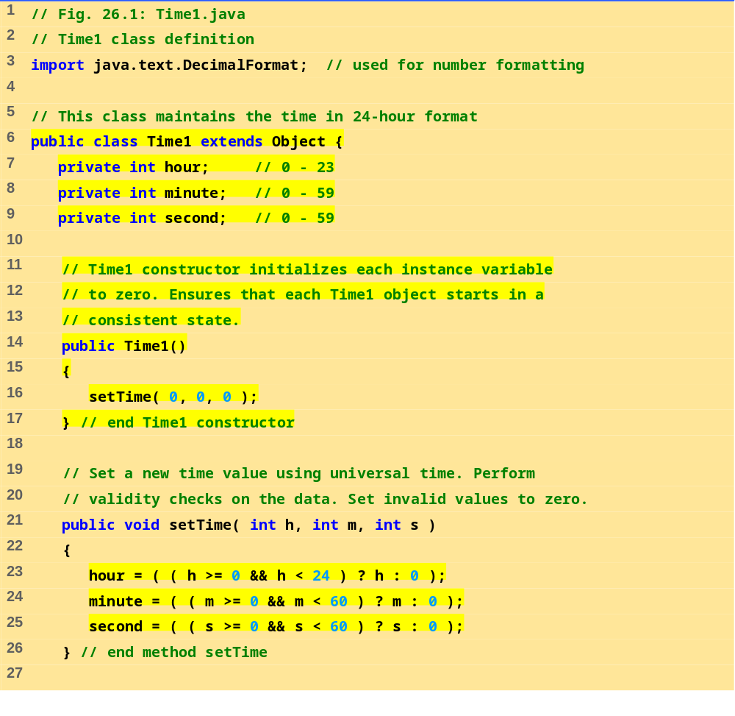
Time1.java (Part 1 of 2)

Slide 10
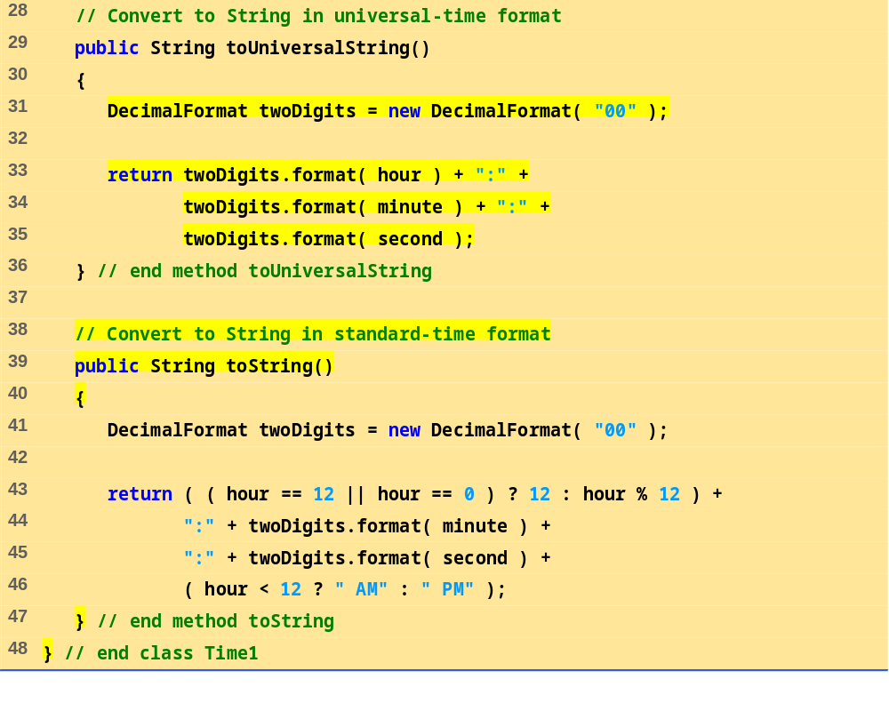
Time1.java (Part 2 of 2)

Slide 11
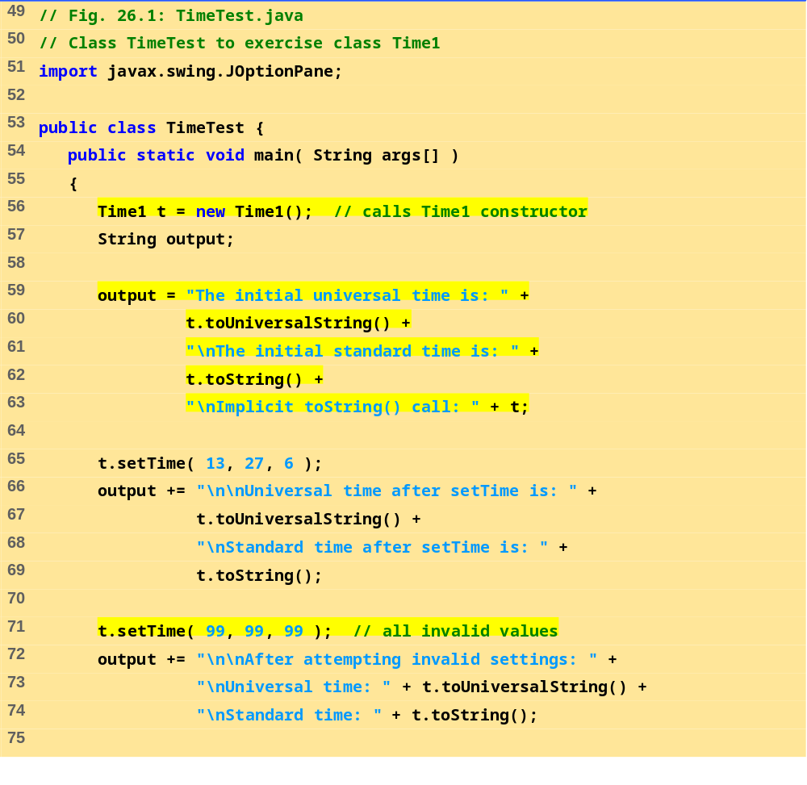
TimeTest.java (Part 1 of 2)

Slide 12
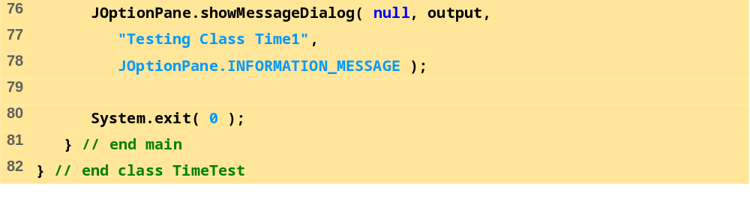
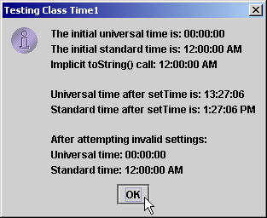
TimeTest.java (Part 2 of 2)
Program Output

Slide 13
26.3 Class Scope
Class scope
  Instance variables and methods
  Class members accessible to methods
    Can be referenced by name
  Outside scope, cannot be referenced by name
  Visible (public) members accessed through a handle
    objectReferenceName.VariableName
Block scope
  Variables defined in a method known only to that method
  If variable has same name as class variable, class variable hidden
  Can be accessed using keyword this (discussed later)

Slide 14
26.4 Creating Packages
Packages
  Directory structures that organize classes and interfaces
  Mechanism for software reuse
Creating packages
  Create a public class
    If not public, can only be used by classes in same package
  Choose a package name and add a package statement to source code file
  Compile class (placed into appropriate directory)
  Import into other programs
  Naming: Internet domain name in reverse order
    After name reversed, choose your own structure
  package com.deitel.chtp3.ch26;
  See text for detailed instructions

Slide 15
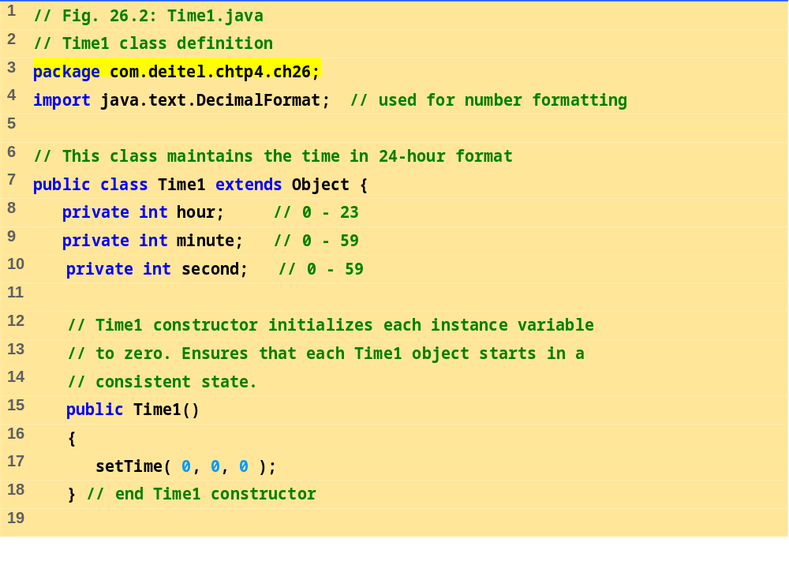
Time1.java (Part 1 of 3)

Slide 16
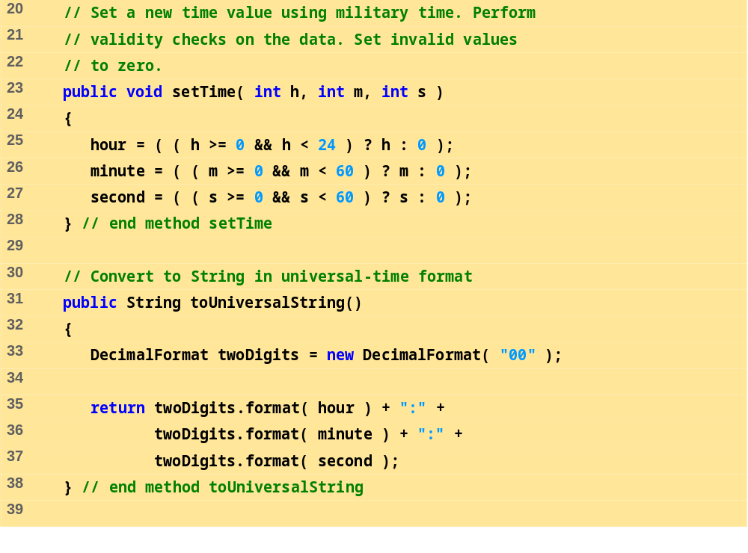
Time1.java (Part 2 of 3)

Slide 17
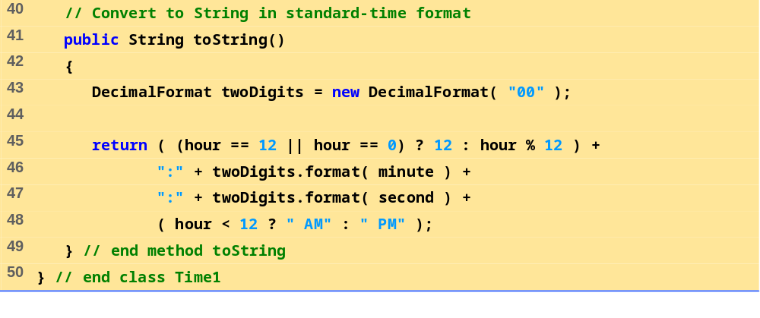
Time1.java (Part 3 of 3)

Slide 18
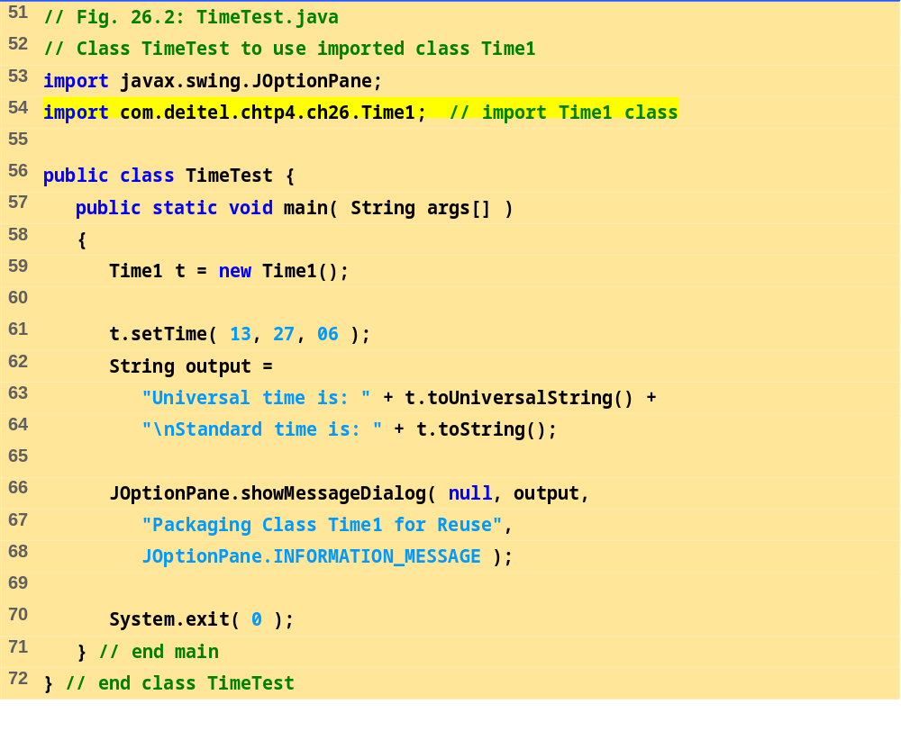
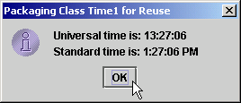
TimeTest.java
Program Output

Slide 19
26.5 Initializing Class Objects: Constructors
Constructor
  Can initialize members of an object
  Cannot have return type
  Class may have overloaded constructors
  Initializers passed as arguments to constructor
  Definition/initialization of new objects takes form:
  ref = new ClassName( arguments );
    Constructor has same name as class
  If no constructor defined, compiler makes default constructor
    Defaults: 0 for primitive numeric types, false for boolean, null for references
    If constructor defined, no default constructor
  Can have constructor with no arguments

Slide 20
26.6 Using Set and Get Methods
Set methods
  public method that sets private variables
  Does not violate notion of private data
    Change only the variables you want
  Called mutator methods (change value)
Get methods
  public method that displays private variables
  Again, does not violate notion of private data
    Only display information you want to display
  Called accessor or query methods

Slide 21
26.6 Using Set and Get Methods (II)
Every event has a source
  GUI component with which user interacted
  ActionEvent parameter can check its source
    Method getSource
  public void actionPerformed( ActionEvent e )
    if ( e.getSource() == myButton )

Slide 22
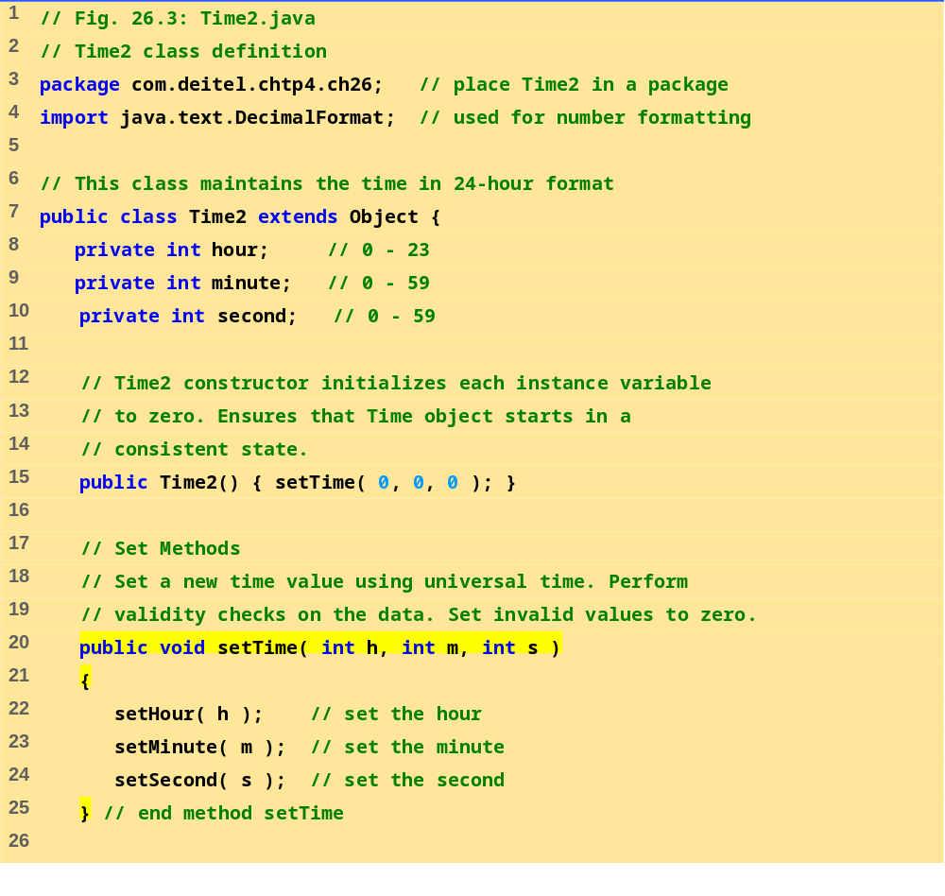
Time2.java (Part 1 of 3)

Slide 23
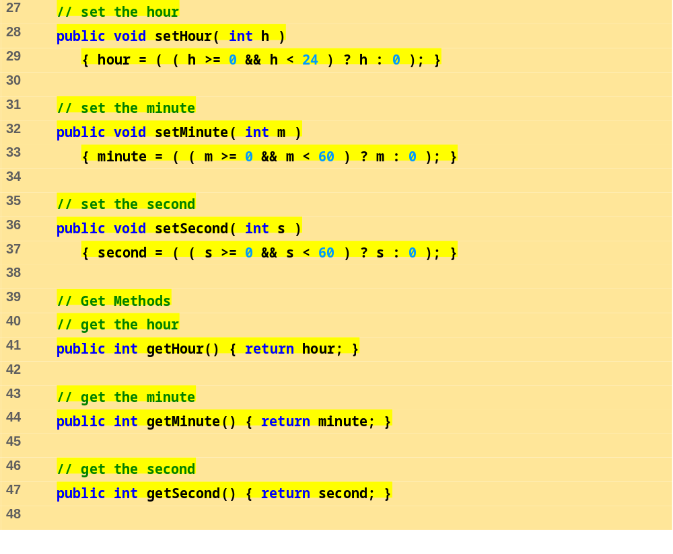
Time2.java (Part 2 of 3)

Slide 24
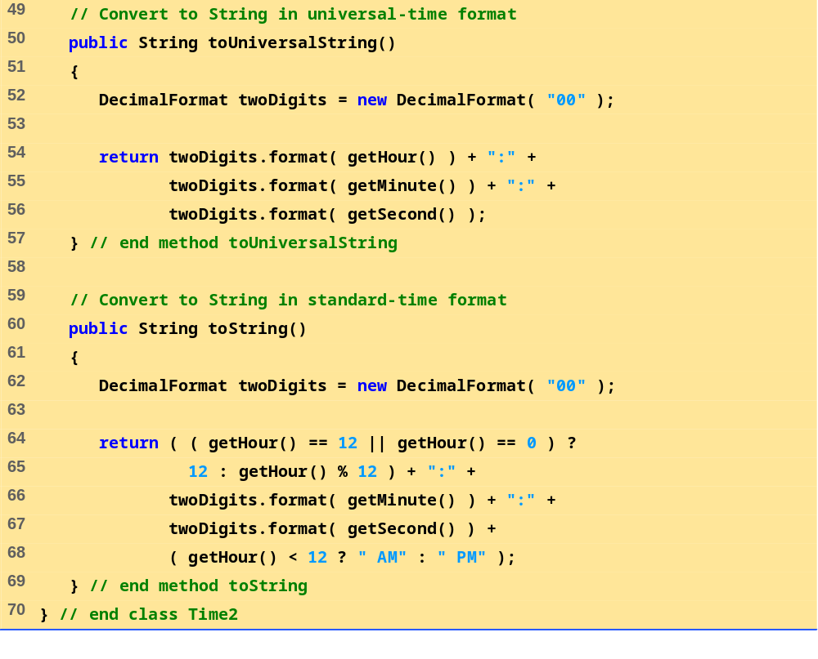
Time2.java (Part 3 of 3)

Slide 25
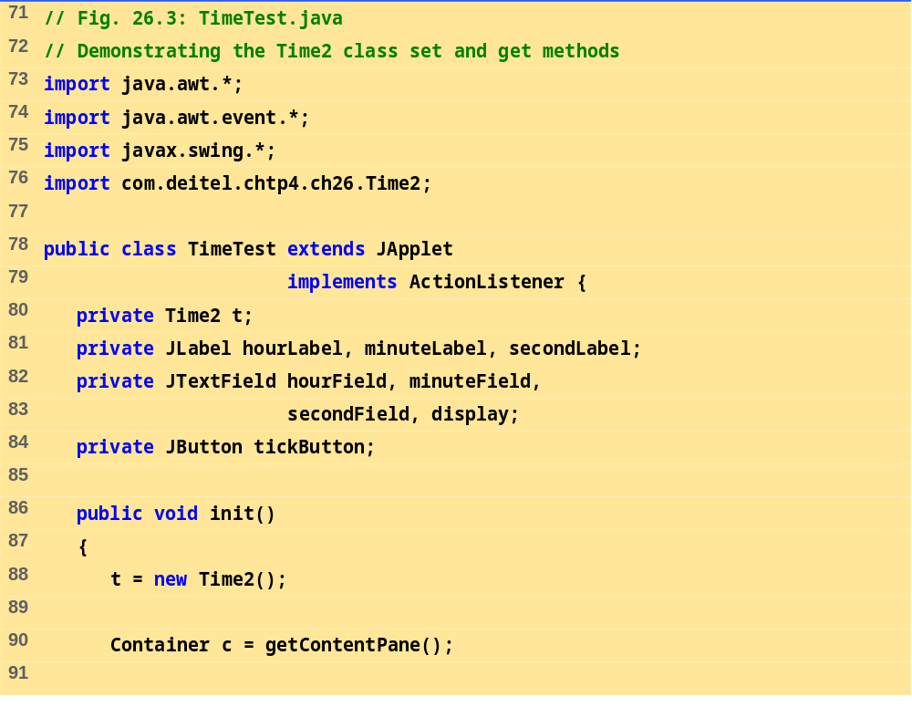
TimeTest.java (Part 1 of 4)

Slide 26
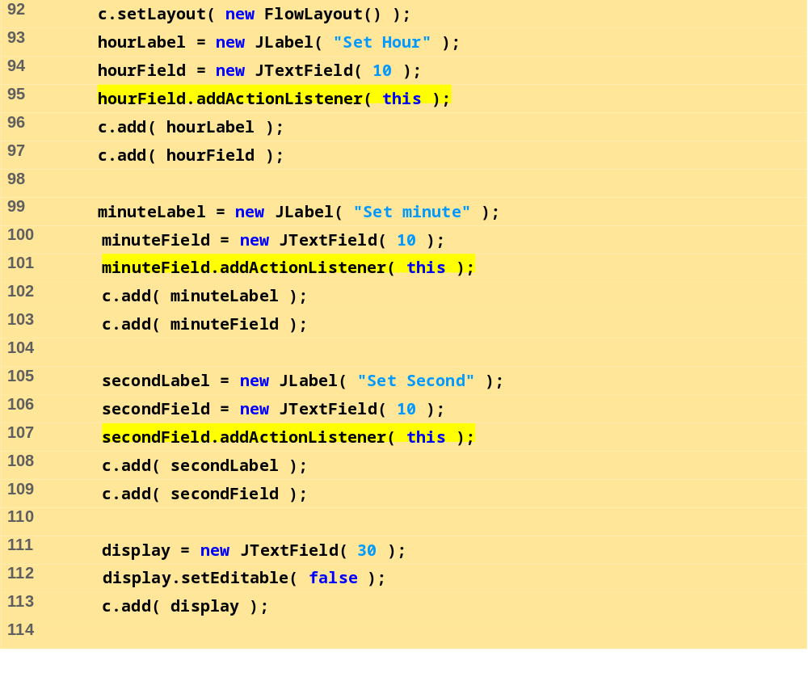
TimeTest.java (Part 2 of 4)

Slide 27
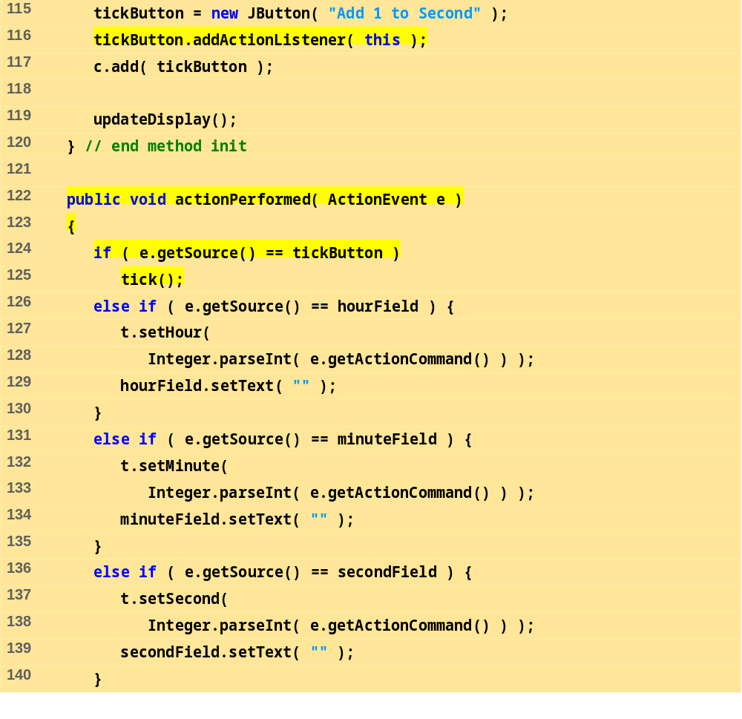
TimeTest.java (Part 3 of 4)

Slide 28
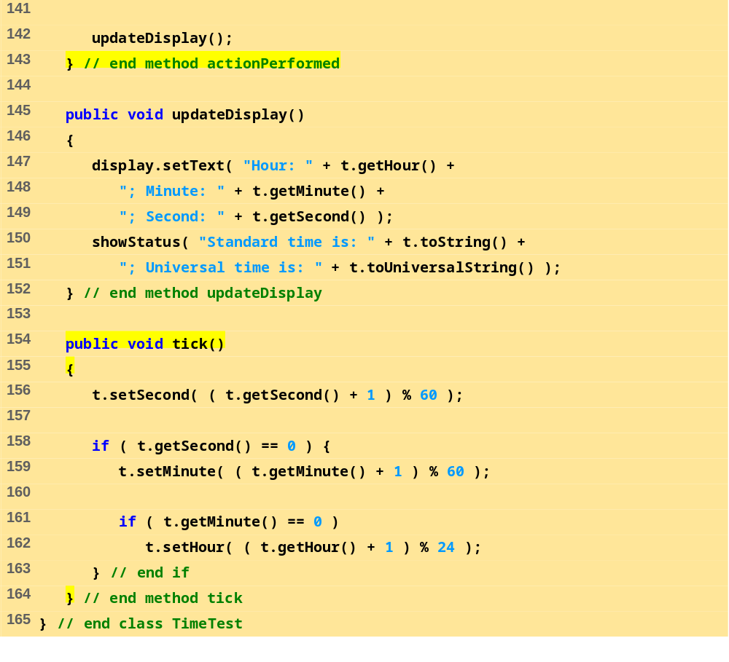
TimeTest.java (Part 4 of 4)

Slide 29
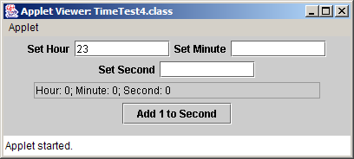
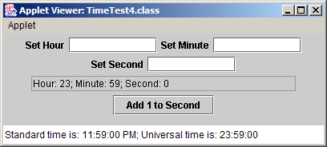

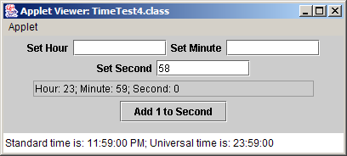
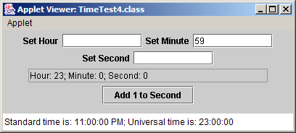
Program Output

Slide 30
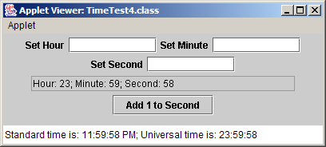

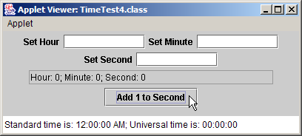
Program Output

Slide 31
26.7 Using the this Reference
Each object has a reference to itself
  The this reference
    Implicitly used to refer to instance variables and methods
Inside methods
  If parameter has same name as instance variable
    Instance variable hidden
  Use this.variableName to explicitly refer to the instance variable
  Use variableName to refer to the parameter

Slide 32
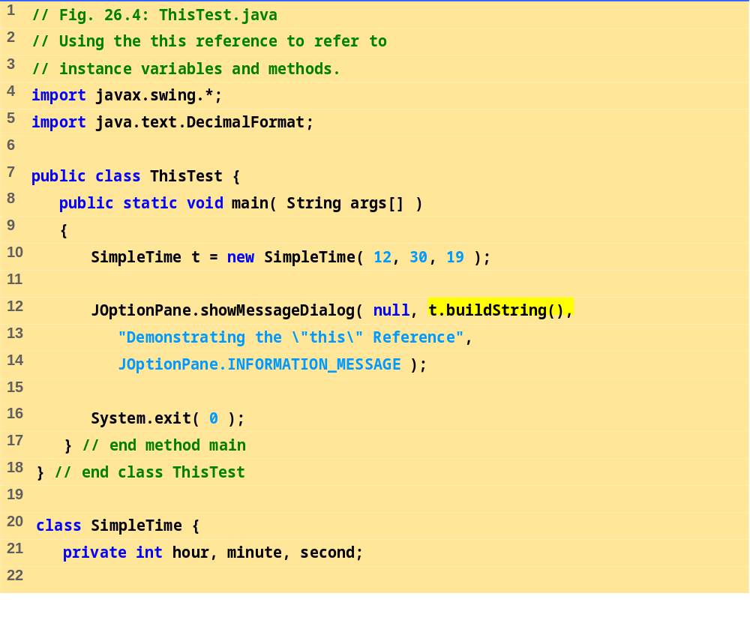
ThisTest.java (Part 1 of 2)

Slide 33
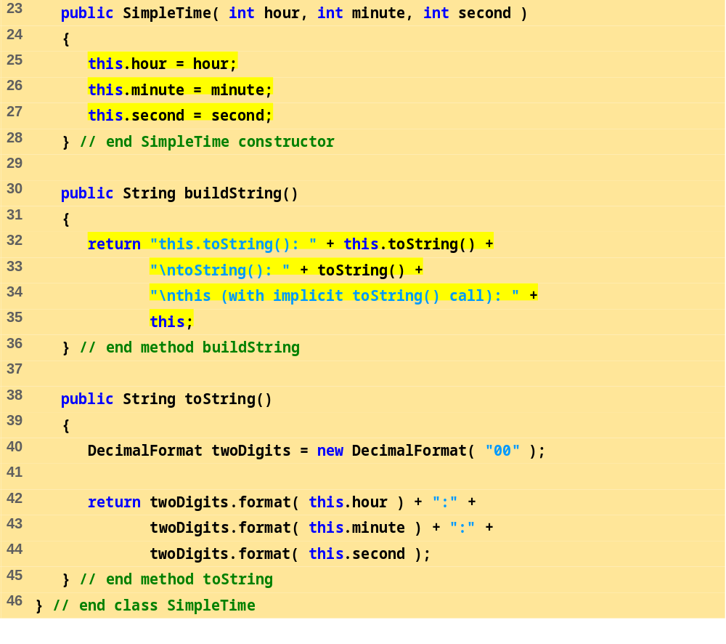
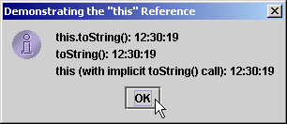
ThisTest.java (Part 2 of 2)
Program Output

Slide 34
26.8 Finalizers
Memory
  Constructors use memory when creating new objects
  Automatic garbage collection
    When object no longer used, object marked for garbage collection
    Garbage collector executes, memory can be reclaimed
    Memory leaks less common in Java than in C and C++
finalizer method
  In every class, returns resources to system
    Performs termination housekeeping on object
  Name always finalize
    Takes no parameters, returns no value
  Defined in class Object as a placeholder
    Every class gets a finalize method

Slide 35
26.9 Static Class Members
Static variables
  Usually, each object gets its own copy of each variable
  static class variables shared among all objects of the class
    One copy exists for entire class to use
  Keyword static
  Only have class scope (not global)
  static class variables exist even when no objects do
  public static members accessed through references or class name and dot operator
  private static members accessed through methods
    If no objects exist, classname and public static method must be used

Slide 36
26.9 Static Class Members (II)
static methods
  Can only access class static members
  static methods have no this reference
    static variables are independent of objects
Method gc
  public static method of class System
  Suggests garbage collector execute immediately
    Can be ignored
    Garbage collector not guaranteed to collect objects in a specific order

Slide 37
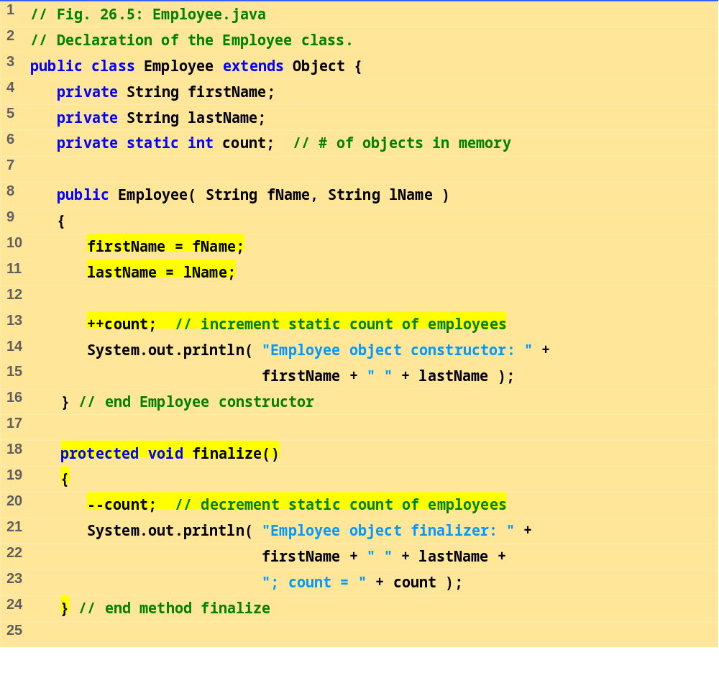
Employee.java (Part 1 of 2)

Slide 38
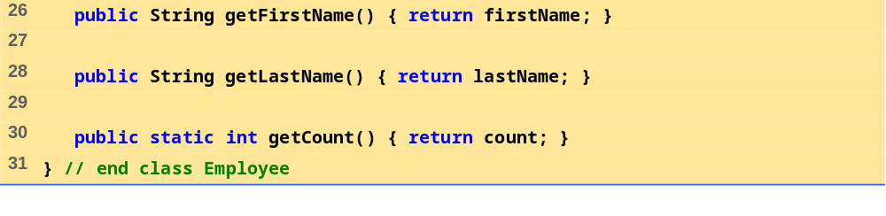
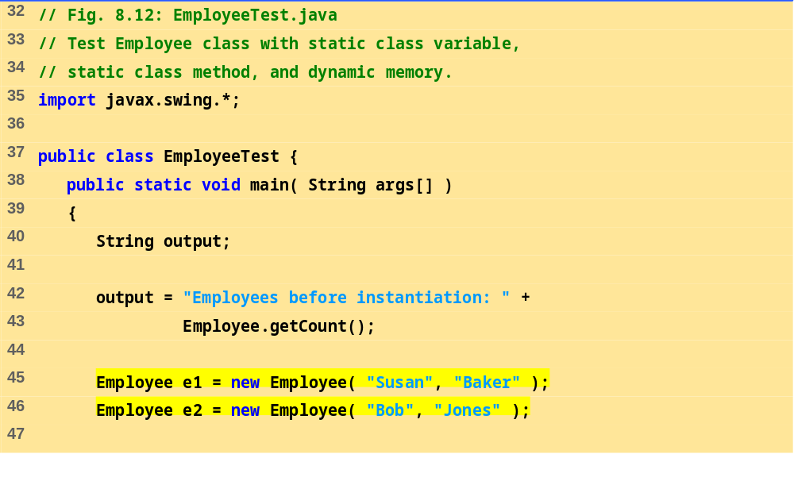
Employee.java (Part 2 of 2)
EmployeeTest.java (Part 1 of 2)

Slide 39
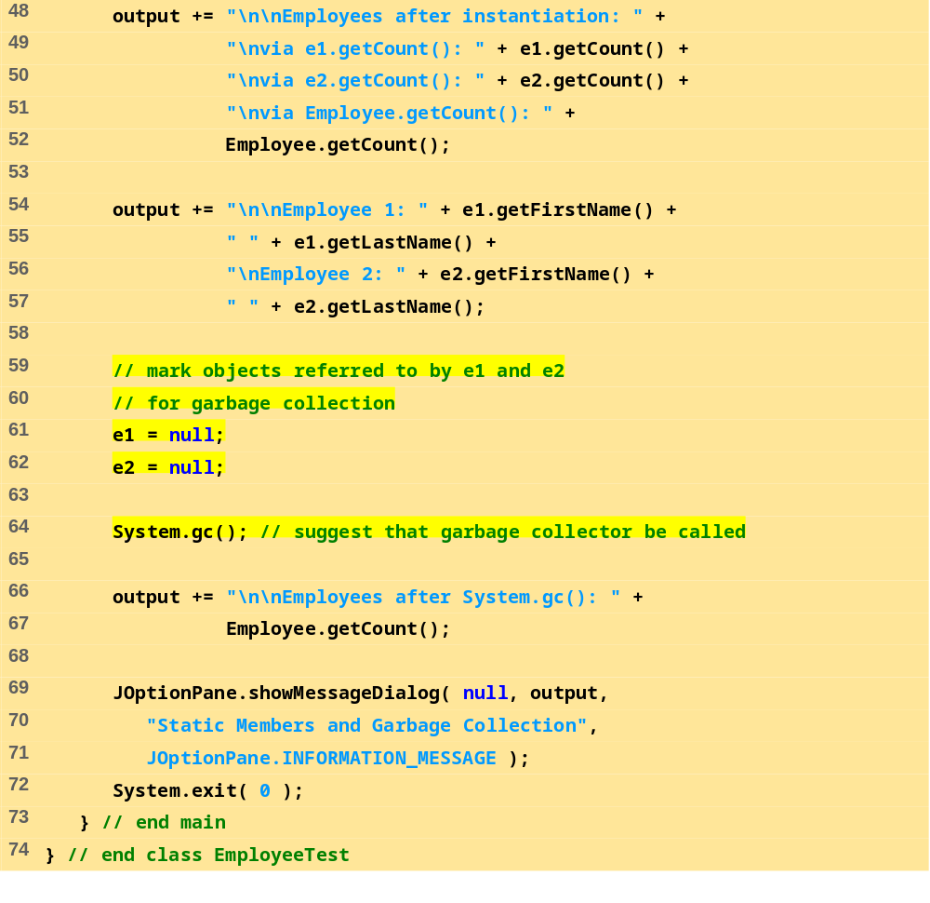
EmployeeTest.java (Part 2 of 2)

Slide 40
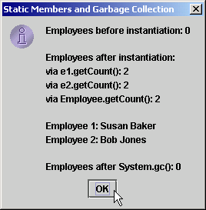
Program Output
Employee object constructor: Susan Baker
Employee object constructor: Bob Jones
Employee object finalizer: Susan Baker; count = 1
Employee object finalizer: Bob Jones; count = 0

